Slide 1
A Convolutional Networks Approach to Sematic Object Segmentation
June 7th, 2017
Phillip Robbins
Notes:
Hi everyone, thanks for coming. Today I am going to present a paper that uses a convolutional Neural Net to segment building footprints in complex scenes

Slide 2
Paper
Yuan, Jiangye. "Automatic Building Extraction in Aerial Scenes Using Convolutional Networks." arXiv preprint arXiv:1602.06564 (2016).
Notes:
The name of the paper discussed is Automatic Building Extraction in Aerial Scenes Using Convolutional Networks by Yuan, Jiangye

Slide 3
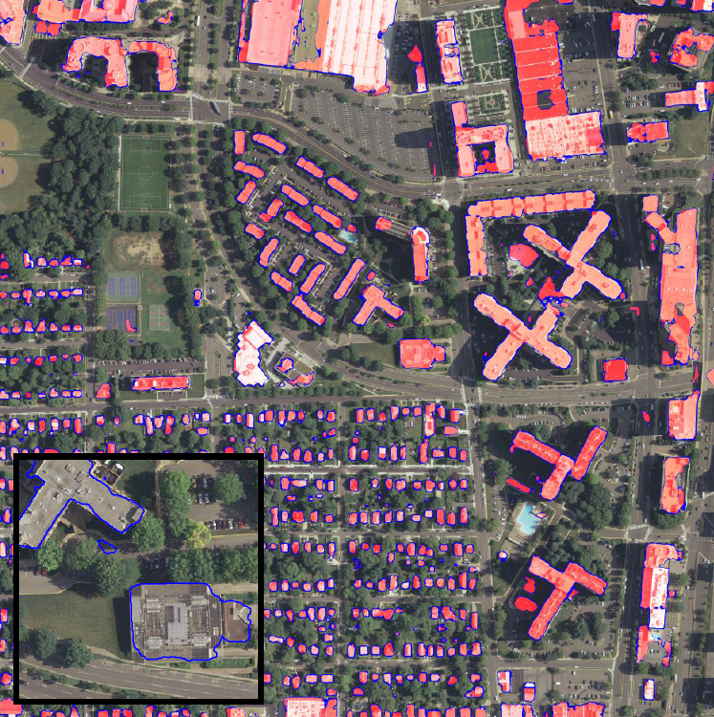
Objective
Create map of building footprints from image.
Requires semantic object detection and segmentation.
Notes:
The main objective of the paper is to extract the building footprints from aerial images, this essentially requires a map of the footprints to be created from of the images of the buildings. This requires semantic object detection to distinguish between buildings and other non-building structures, like a parking lot, and to segment the objects in the image.

Slide 4
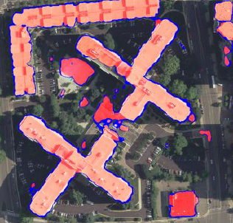
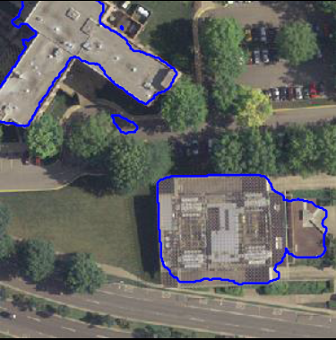
Contours Vs Regions
For segmenting buildings, there are two commonly used output representations:
Region Maps – or - “Masks”
Representing the pixels corresponding to the building
Building Outlines
Representing the contours/boundaries of the buildings
Notes:
For segmenting buildings, there are two commonly used output representations:
Region Maps – or - “Masks”
Representing the individual pixels corresponding to the building
Building Outlines
Representing the contours/boundaries of the buildings

Slide 5
Contours Vs Regions
Output Representations | Weaknesses
Boundary maps | Contour maps do not guarantee closed contours and hence may produce significantly misshaped building outlines Abandons valuable information of whether pixels are inside or outside buildings
Region maps | Cannot represent boundaries of adjacent buildings
Notes:
Individually, both these representations have some weaknesses. Namley, for boarder or contour maps:
The extracted contours do not guarantee to be closed contours could produce misshaped building outlines
Contour representation also abandons valuable information of whether pixels are inside or outside buildings
For region maps; If two buildings are adjacent, we loose the information that represents the boundary between them.

Slide 6
The Challenge
Challenges | Strengths
Require large training sets, often hard to collect and label data | Massive amounts of georeferenced data is available from various GIS sources
Good at extracting multiscale hierarchical information | Pooling stage discards spatial information that is crucial segmentation
Well established performance in image classification problems | Not many effective applications for object segmentation
Notes:
The approach of using a Convolutional Networks itself has its challenges and strengths, namely:

Slide 7
The Challenge
Challenges | Strengths
Require large training sets, often hard to collect and label data | Massive amounts of georeferenced data is available from various GIS sources
Good at extracting multiscale hierarchical information | Pooling stage discards spatial information that is crucial segmentation
Well established performance in image classification problems | Not many effective applications for object segmentation
Notes:
Deep CNNs have well established performance in image classification problems, but not many effective applications for segmentation of semantic objects

Slide 8
The Challenge
Challenges | Strengths
Require large training sets, often hard to collect and label data | Massive amounts of georeferenced data is available from various GIS sources
Good at extracting multiscale hierarchical information | Pooling stage discards spatial information that is crucial segmentation
Well established performance in image classification problems | Not many effective applications for object segmentation
Notes:
CNNs are good at extracting multiscale hierarchical information from images, but the pooling stage discards spatial information that is crucial for dense prediction of segmentation regions

Slide 9
The Challenge
Challenges | Strengths
Require large training sets, often hard to collect and label data | Massive amounts of georeferenced data is available from various GIS sources
Good at extracting multiscale hierarchical information | Pooling stage discards spatial information that is crucial segmentation
Well established performance in image classification problems | Not many effective applications for object segmentation
Notes:
CNNs require large training sets that are often involve very labour intensive collect and manually label in order to provide robust classification and the ability to generalize classification beyond the training sample. Fortunately, for the building footprints massive amounts of georeferenced data is available from various GIS sources.

Slide 10
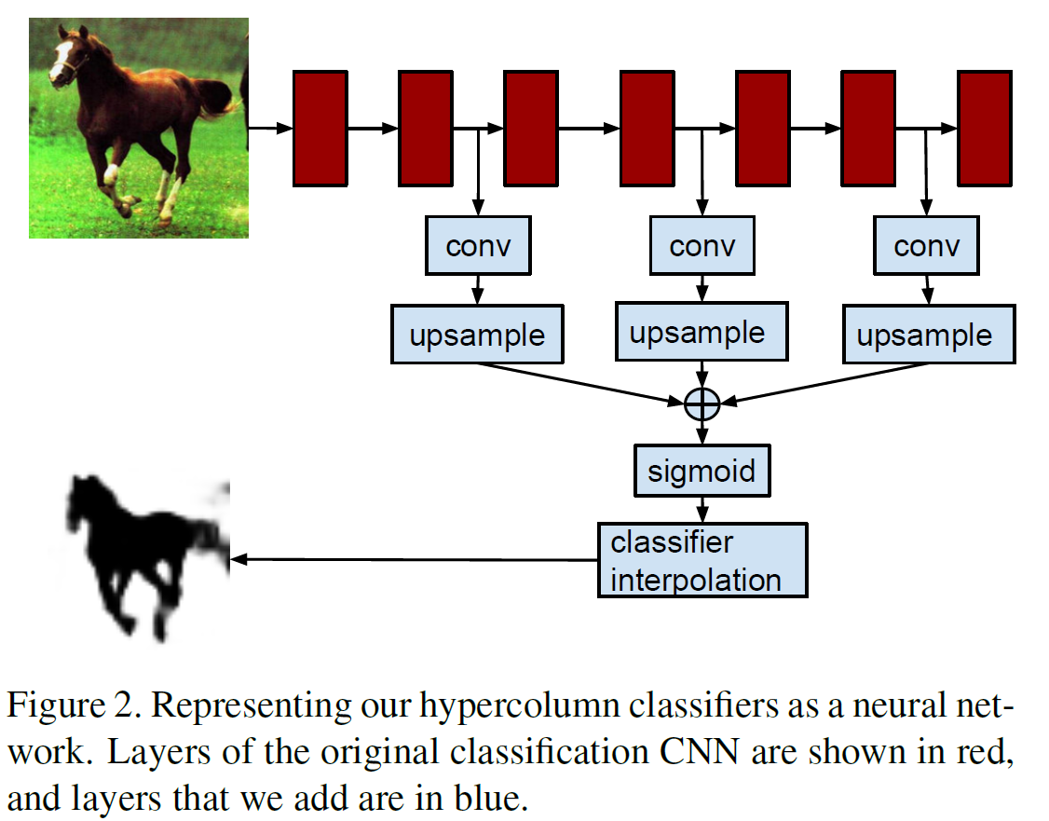
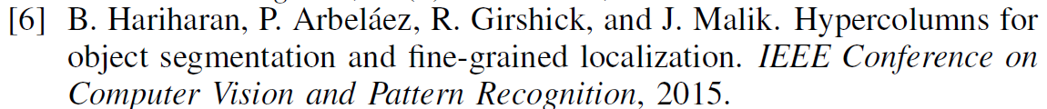
Purposed Solutions
To achieve pixel level segmentation using CNN, the author proposed to combine information from multiple feature map at different “scale levels” (or layers) in the network.
Notes:
To deal with some of these challenges in CNNs and the segmentation problem, the author proposed to combine information from multiple feature map at different “scale levels” (or layers) in the network.
To deal with the challenges that CNNs have in object segmentation he implemented the solution presented in the paper “Hypercolumns for object segmentation and fine-grained localization” by Hariharan et al

Slide 11
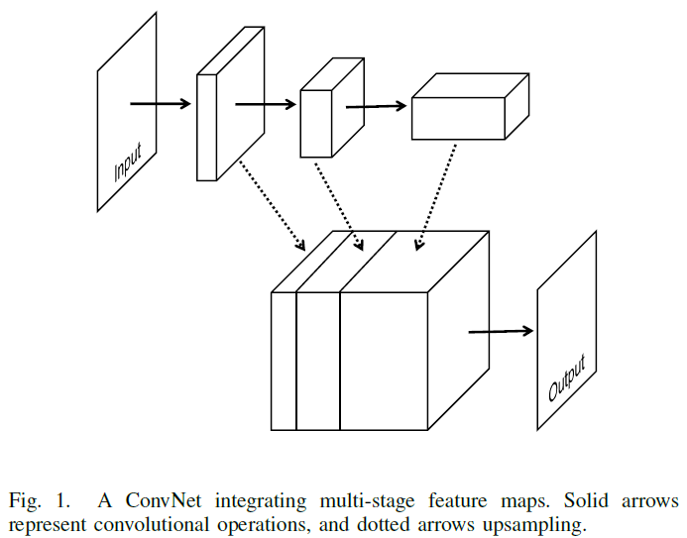
Purposed Solutions
Output maps from each consecutive layer are upsampled to the size of the input image using bilinear interpolation.
Notes:
The paper by Hariharan showed that upsampling the feature through bilinear interpolation maps after each pair of convolution & pooling layer in order to preserve the spatial information.

Slide 12
Architechture
The first stage
applies 50 filters of size 5X5 X3 to a 500X500X3 input image
2x2 Max pooling kernel
Each of the following three stages:
Convolutional layers have 70 filters of size 5X5X50
100 filters of size 3X3X70
and 150 filters of size 3X3X100, respectively
Notes:
I will go over the architecture briefly since I don’t believe it is really important in this paper, and it’s a bit boring. The first stage applies 50 filters of size 5X5 X3 to a 500X500X3 input image and performs non-overlapping max-pooling over a 2X2 unit region. Each of the following three stages has a similar structure containing both a convolutional layer and a max-pooling layer. Convolutional layers have 70 filters of size 5 5 50, 100 filters of size 3 3 70, and 150 filters of size 3 3 100, respectively. Each of the next three stages filters the output from its preceding stage and produces feature maps without max-pooling, where convolutional layers has 100 filters of size of 33150, 70 filters of size of 33100, and 70 filters of size of 3 3 70, respectively. In feature maps output from the seventh stage, each unit has an effective receptive field of 148148, which is sufficiently large to cover most individual buildings in the dataset.

Slide 13
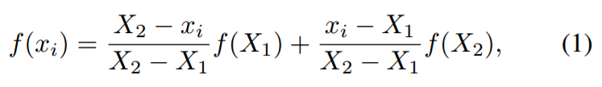
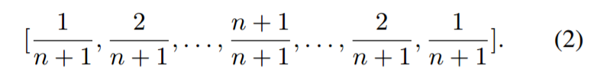
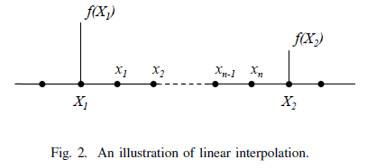
Backpropagation with bilinear interpolation upsampling
The upsampling of the feature maps is done with simple 2D bilinear interpolation between pixels
1D example:
Can be represented by a convolution operation with kernel:
(where n is the number of unknown pixels)
Notes:
To include the upsampling through builinear interpolation in the training of the network we need to define the operation as a convolution operation on the feature maps.
The upsampling of the feature maps is done with simple 2D bilinear interpolation between pixels
The additional pixels inserted to increase the size of the feature maps are set to a value of zero, then the convolution operation with the bilinear interpolation kernel populates the pixels with the interpolated values

Slide 14
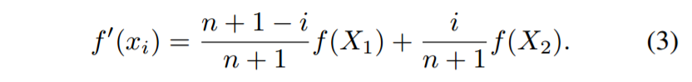
Backpropagation with bilinear interpolation upsampling
The backpropagation of errors is calculated using the derivative of the interpolation operation.
Notes:
With this definition we can calculate the gradient of the convolution kernel that acts as the interpolation operation. This is then used to calculate the backpropagation of errors to the convolution kernals of the CNN in each layer.

Slide 15
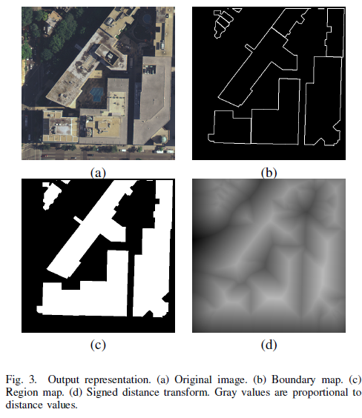
Signed distance function: Output Representation
The magnitude represents its distance to the building boundary.
The sign represents if the pixel is in or outside the building boundary
Notes:
The output was represented as a signed distance function: The magnitude of signed distance function value at each pixel represents its distance to the building boundary.
The sign of the function represents weather the pixel is in or outside the building boundary
This, the author argues… is significant since its output format can influences the type of information cues learnt.

Slide 16
Data
Aerial images at 0.3 m resolution covering Washington D.C. area
Building footprint from public GIS database. downloaded from:
http://opendata.dc.gov/
http://www.openstreetmap.org
The images tiled into 500x500 pixels that contained complete building footprints.
Misalignment in georeferenced data between the building footprint and aerial imagery was corrected
Notes:
Some comment on the data and data prep collection of aerial images at 0.3 meter resolution covering the entire Washington D.C. area
corresponding building footprint layer in form of vector data downloaded from a public GIS database
http://opendata.dc.gov/
http://www.openstreetmap.org
The images were also tiled into 500x500 sized images that contained complete building footprints in order to obtain meaningful outputs with the signed distance function
Misalignment in georeferenced data between the building footprint and aerial imagery was also corrected by calculating the highest correlation coefficient.

Slide 17
Results
Ten test images were used without the preprocessing described earlier (tiling, fixing misalignments).
Results of two images are shown in Fig. 4 & 5,
Pixels with output values between -0.5 and 0.5 are marked in blue and pixels with output values larger than 0.5 are marked in transparent red:
Notes:
In the experiment ten test images were used without the preprocessing described earlier (tiling, fixing misalignments).
Results of two images are shown in Fig. 4 & 5, where pixels with output values between -0.5 and 0.5 are marked in blue and pixels with output values larger than 0.5 are marked in transparent red:

Slide 18
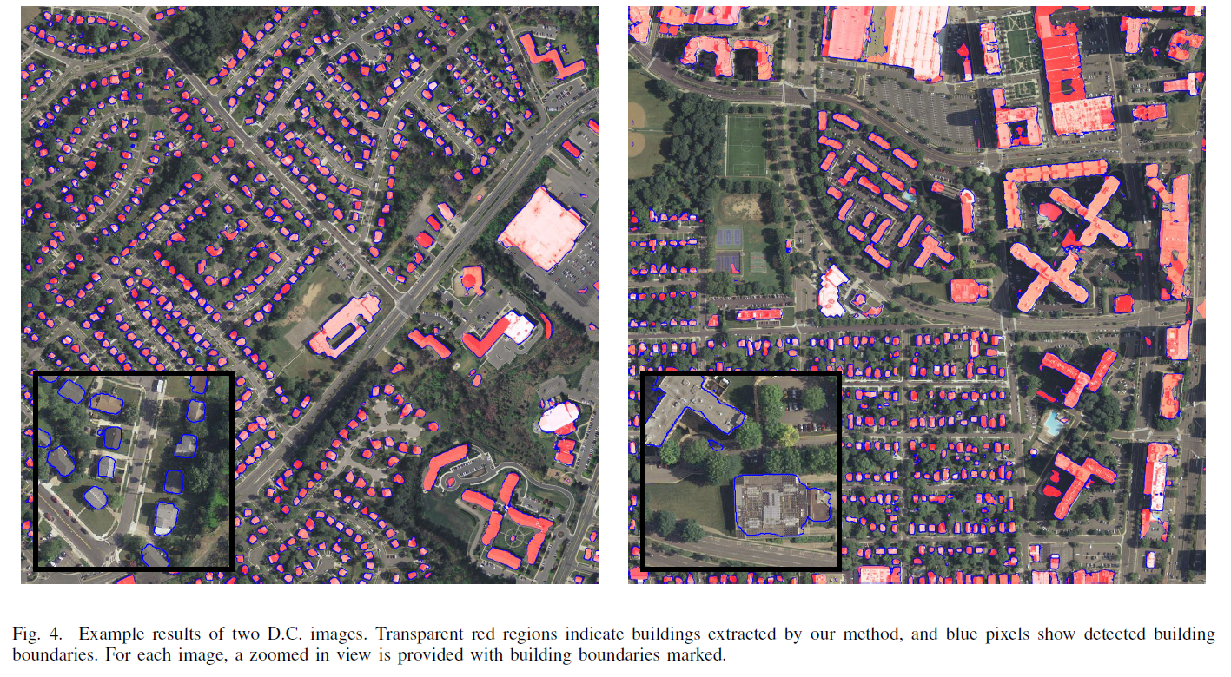
Results

Slide 19
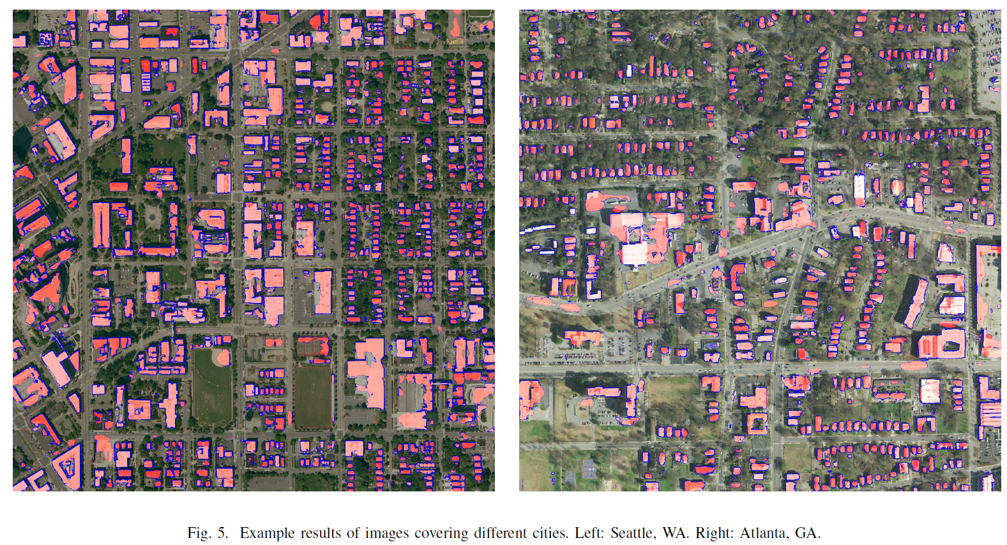
Results

Slide 20
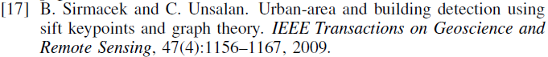
Results
The authors claim they cannot find any commercial software or software from published work that produces reasonable extraction results on their test data.
The compared their results to an easier problem of building detection.
Results compared to the centroid of their detected region to the building detection method proposed by Sirmacek and Unsalan [17].
Results in Table 1 show True Positives (TD) and False Positives (FA) of the two methods

Slide 21
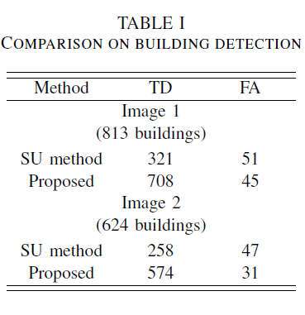
Results
The papers method significantly out performs the building detection method in both True Positives and False Positives for both images

Slide 22
Conclusions
The output representation used can influences the type of information cues.
GIS data is a strong candidate for CNN training
Georeferenced data requires upsampling
Ability to generalize the sample data to both urban and suburban scenes
Notes:
The output representation used in CNN training is significant since its format can influences the type of information cues.
GIS data is a strong candidate for CNN training due to its general availability and labeled nature
Georeferenced data requires upsampling to preserve spatial information in CNNs due to pooling layers.
CNN systems have shown an impressive ability to generalize the sample data to both urban and suburban scenes

Slide 23
Thank You

